Slide 1
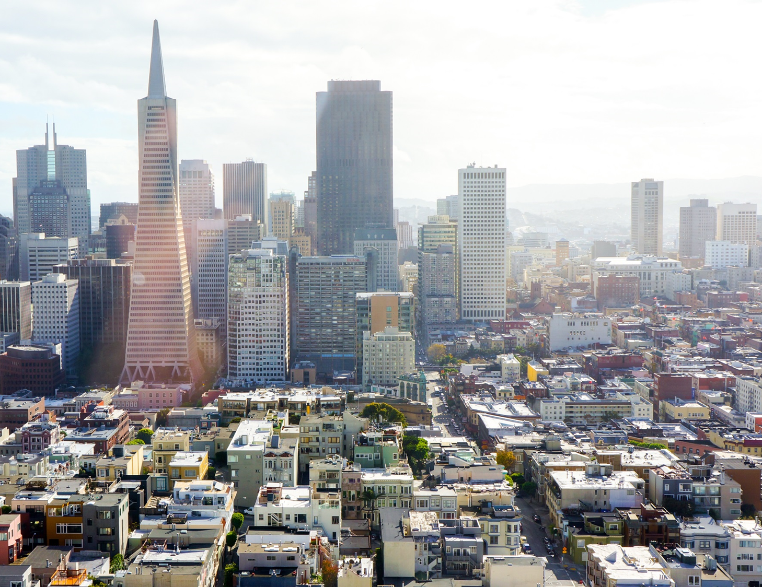


黄浦区建筑能耗监测平台
项 目 验 收 汇 报
黄浦区电力需求响应试点（二期）
在电力需求响应试点（一期）项目的基础上，深化需求响应调度管理应用，建设部署规模化的建筑需求响应软硬件基础
实现电力需求响应资源的规模化、多样化、智能化、标准化。

Slide 2
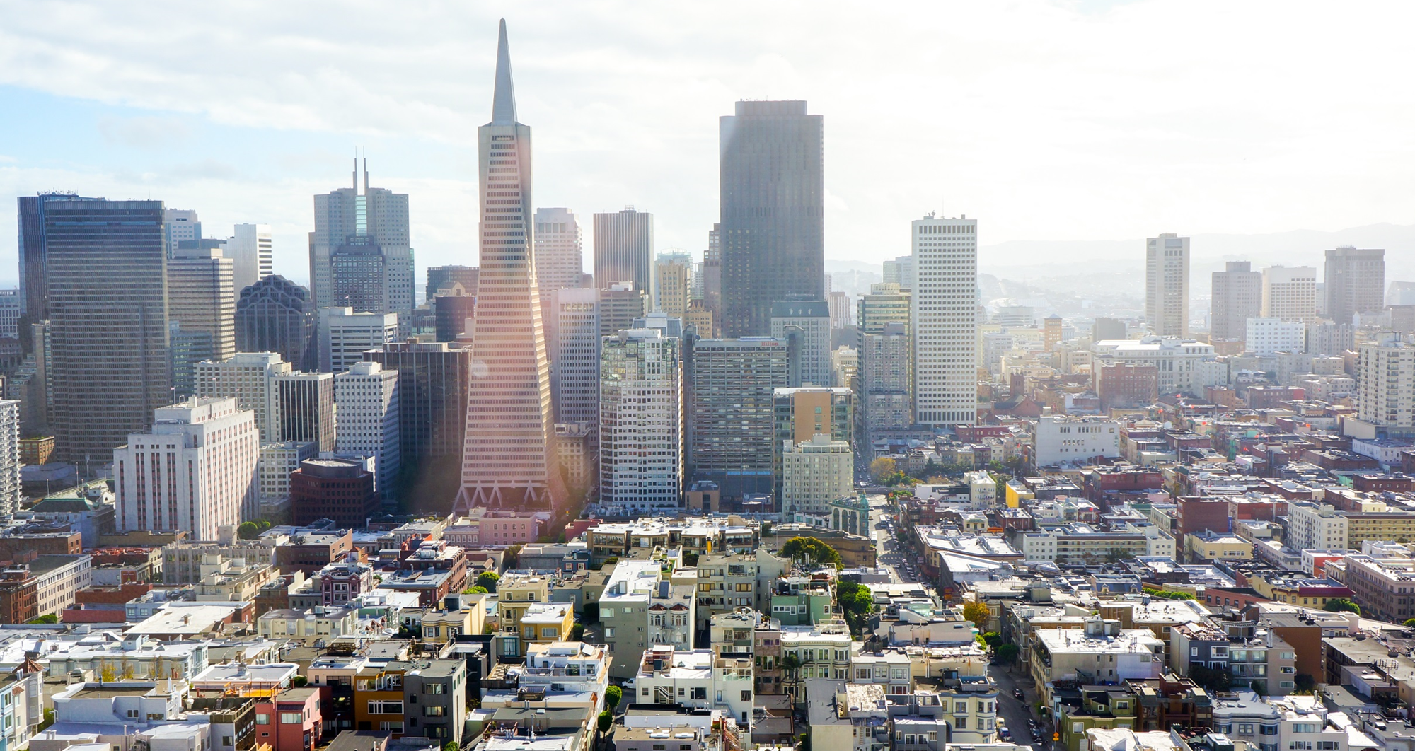
汇 报目 录
01
02
ABOUT THIS PROJECT
PROJECT PROGRESS
项目介绍
完成情况
03
04
INTRODUCTION
DEMONSTRATES
功能介绍
系统展示

Slide 3
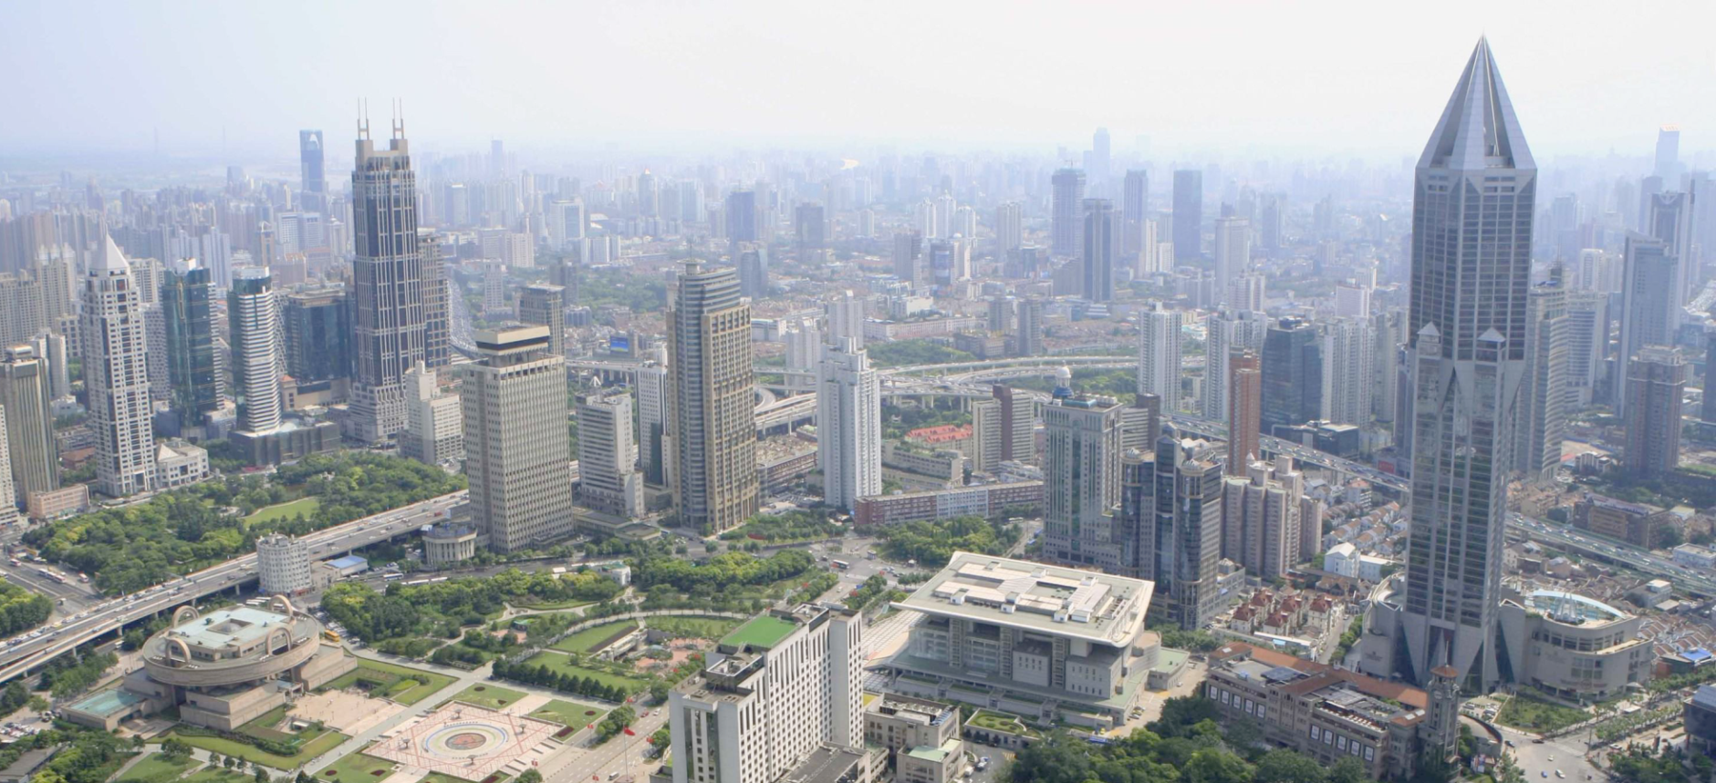
ABOUT This Project
项目介绍
电力需求响应
试点（二期）
为贯彻党的十八大创新、协调、绿色、开放、共享的发展理念，落实《国务院关于积极推进“互联网+”行动的指导意见》要求，黄浦区“十三五”规划纲提出要全面推进“互联网+”智慧能源发展,建立建筑能耗大数据平台，在全市率先开展电力需求侧管理试点,实现对区内重点建筑能耗数据的实时监测和科学管理
黄浦区建筑能耗监测平台目前接入大型公共建筑超过230幢，累计了上万监测点的负荷运行规律。2015年实施了黄浦区电力需求侧响应试点（一期）项目。为探索区域智慧能源发展，进一步有效缓解高峰用电负荷，我区计划实施“黄浦区电力需求响应试点（二期）项目”
2016年,为探索区域智慧能源发展，进一步有效缓解高峰用电负荷，黄浦区计划实施“黄浦区电力需求响应试点（二期）项目”

Slide 4
ABOUT This Project
建设目标
规 模 化
多 样 化
升级响应规模，增加响应参与楼宇资源30幢，实现平台总需求响应能力达10MW，进一步发挥区级能耗在线监测平台需求侧管理应用创新
新增加智能电网微单元试点类型，建筑内大用户单位试点，形成多种需求响应技术路线与解决方案
智 能 化
标 准 化
新增自动需求响应试点类型，实现建筑自动智能需求响应系统建设，提升需求侧资源自动化水平，建成全国资源化自动需求响应样板
实现智能电网需求响应协议OPENADR协议支持

Slide 5

PROJECT PROGRESS
完成情况
和30幢楼宇签订了需求响应合作协议
实施了三次需求响应试验，并达到了预期的效果
完成了近60幢楼宇的深度调研，并形成了初步的楼宇需求响应方案
对参与需求响应的楼宇进行了数据校核，并确保了数据采集的正常

Slide 6
PROJECT PROGRESS
完成情况
2017/3/21下午14:00-15:00进行了第二次需求响应试点（过渡季），并实施了一幢自动需求响应试点楼宇，参与楼宇48幢，响应负荷削减5MW
每次实施参与楼宇数为50幢/次。项目累计的响应负荷削减达到了25MW
2017/1/12下午14:00-15:00进行了第一次需求响应试点（冬季），参与楼宇50幢，响应负荷削减10MW
2017/3/29下午14:00-15:00进行了第三次需求响应试点（过渡季）,参与楼宇50幢，响应负荷削减5MW

Slide 7
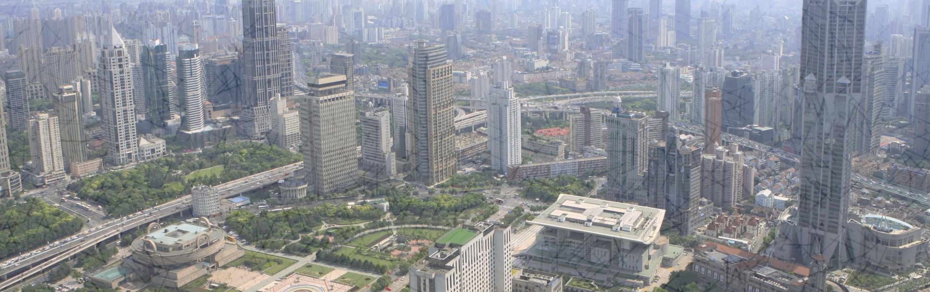
ABOUT SYSTEM
系统介绍
基 线 算 法
用 户 交 互
响 应 结 算
在国际基线几种计算方法的基础上，根据实际用电情况进行进一步修正，提出黄浦项目的基线测算方法
更加方便自由的用户参与方式，通过管理员选择合适的参与楼宇后，楼宇用户可以执行反馈是否参与本次需求响应事件
系统自动生成详细的用户参与情况表格，表格内容包括各用户基线，实际负荷，削减量等信息，使管理员快速完成结算操作
基线算法通过数据选择，数据排除，基线计算，修正算法几个步骤实现了基线计算。同时将之前的单一平均基线数据扩展为了每十五分钟基线数据，提高了基线精度
通过结算图表，明确表示出各次响应事件整体削减情况以及各个用户的参与情况
用户可以通过业主版平台，或者收到的微信推送信息，快速选择参与，不参与操作

Slide 8

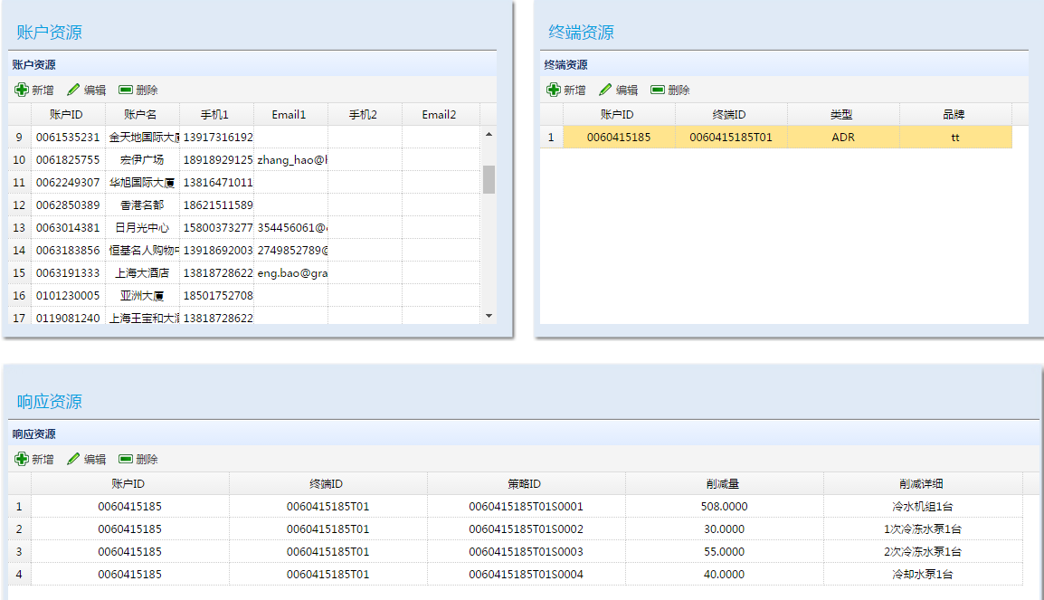
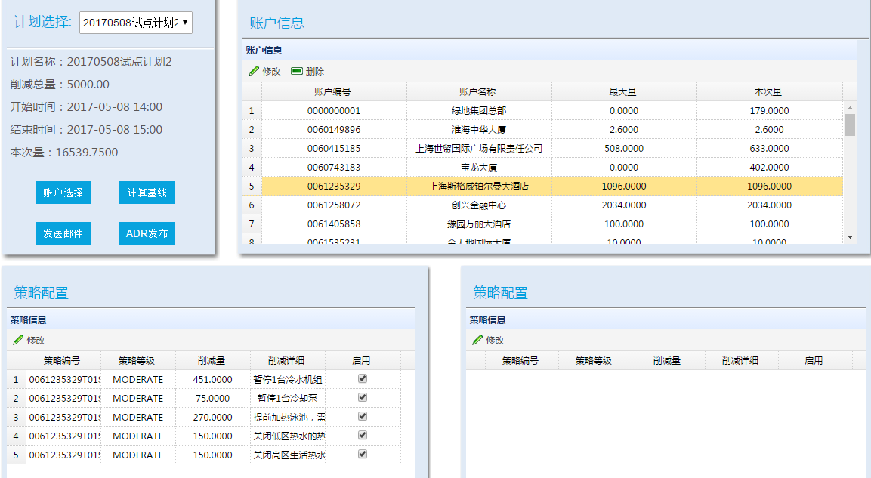
INTRODUCTION
功能介绍
响应资源配置
账户策略配置
现场调研
资源配置是系统最基础的数据。通过账户资源、终端资源、响应资源三个层次，对所有参与需求响应的用户资源进行配置。在需求响应事件开始前，根据配录入的响应资源，制定合理的响应策略
根据之前录入的响应资源，结合需求响应事件目标削减量，对参与本次事件的楼宇进行选择。在选择楼宇之后，还可以进一步针对每一个楼宇的每一个资源进行是否参与以及参与时间的配置
分项计量与需求响应工程师进入参与楼宇现场，调研楼宇的配电与设备情况，再结合物业人员工作经验，准确的制定负荷削减策略

Slide 9
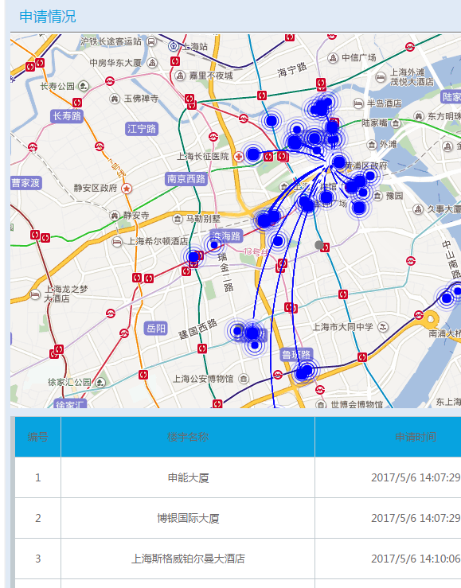
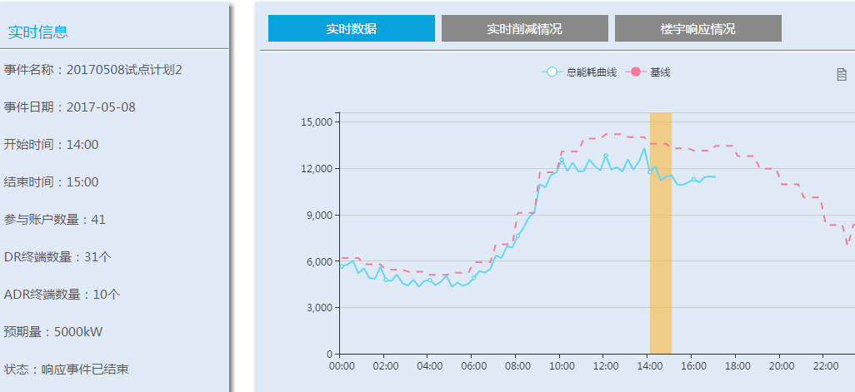
INTRODUCTION
功能介绍
实 时 监 测
通过系统实时监测页面,可以实时查看需求响应事件基本信息，所有参与楼宇实际负荷曲线，基线曲线，需求响应时间范围等信息。同时通过地图和表格，查看各个参与楼宇的参与交互情况

Slide 10
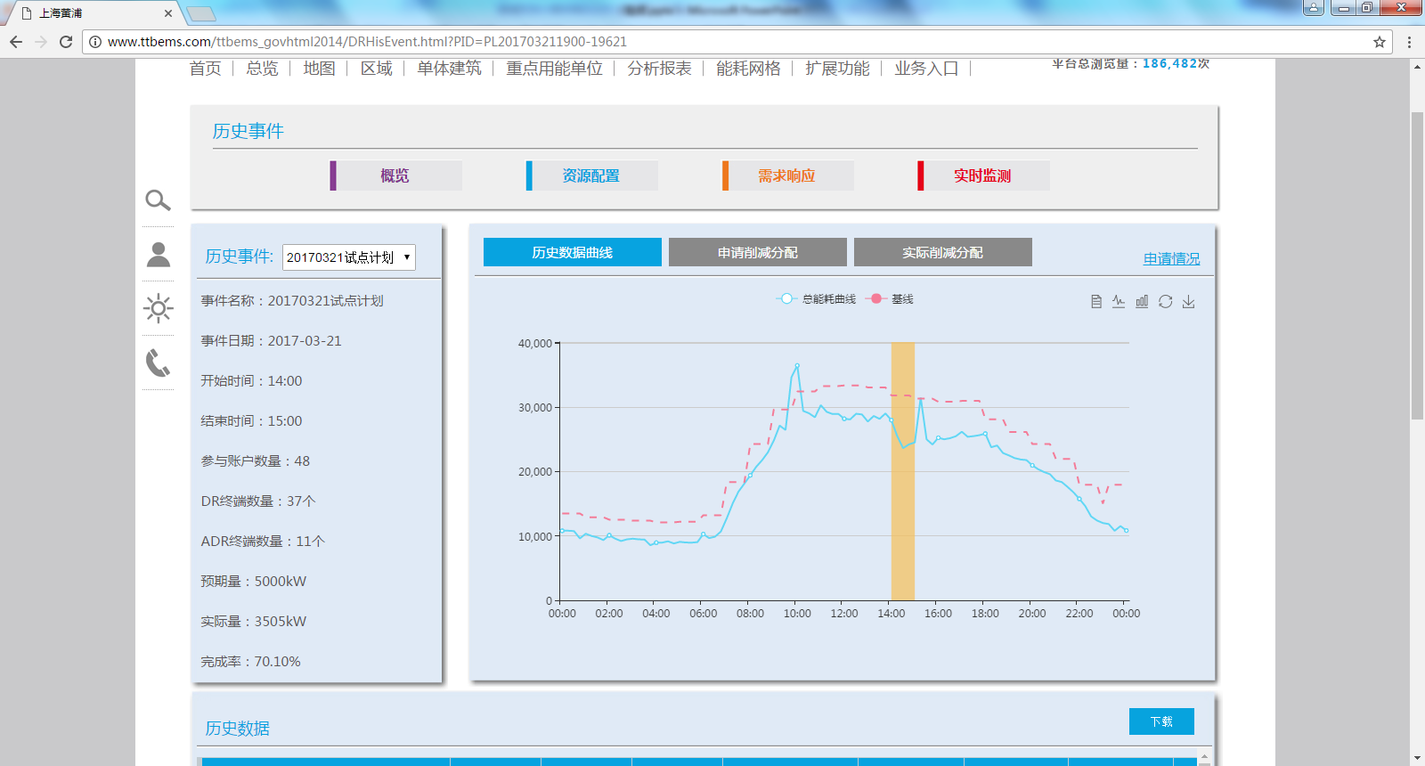
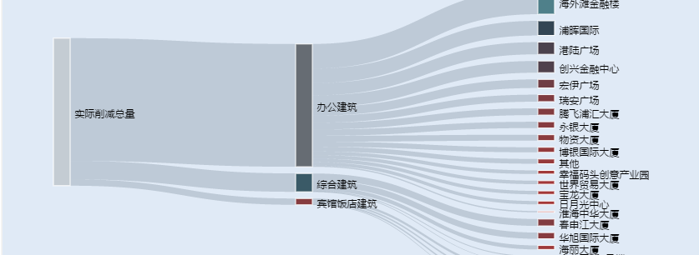
INTRODUCTION
功能介绍
历 史 事 件 分 析
通过多种图表形式,展示曾经进行的需求响应事件基础信息、负荷削减情况、楼宇参与情况等信息
通过折线图，反应历史需求响应事件的负荷相减量与基线的对比信息。通过桑基图，反应实际削减量的分解情况
通过历史数据表，展示参与楼宇基线，负荷，削减量等详细数据

Slide 11

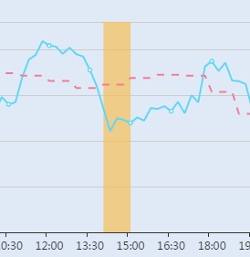
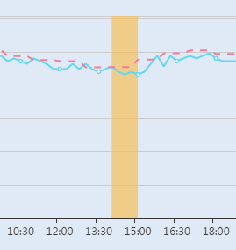
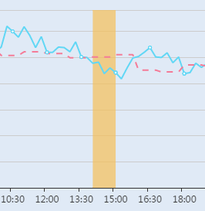

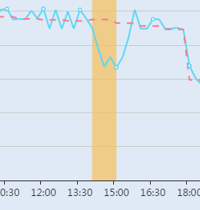
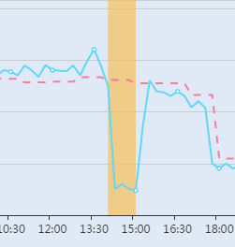
INTRODUCTION
功能介绍
部 分 楼 宇 削 减 情 况
通过历史事件查看功能，可以详细的查看每一次需求响应事件中，每一个参与楼宇的负荷削减情况
01
02
03
华旭国际大厦
雅居乐万豪酒店
豫园万丽大酒店
06
05
04
日月光中心
宝龙大厦
港陆广场

Slide 12
黄浦区电力需求响应试点（二期）
THANKS
学习创新，扬长避短，砥砺前行，不断尝试！
平台系统演示

Slide 13
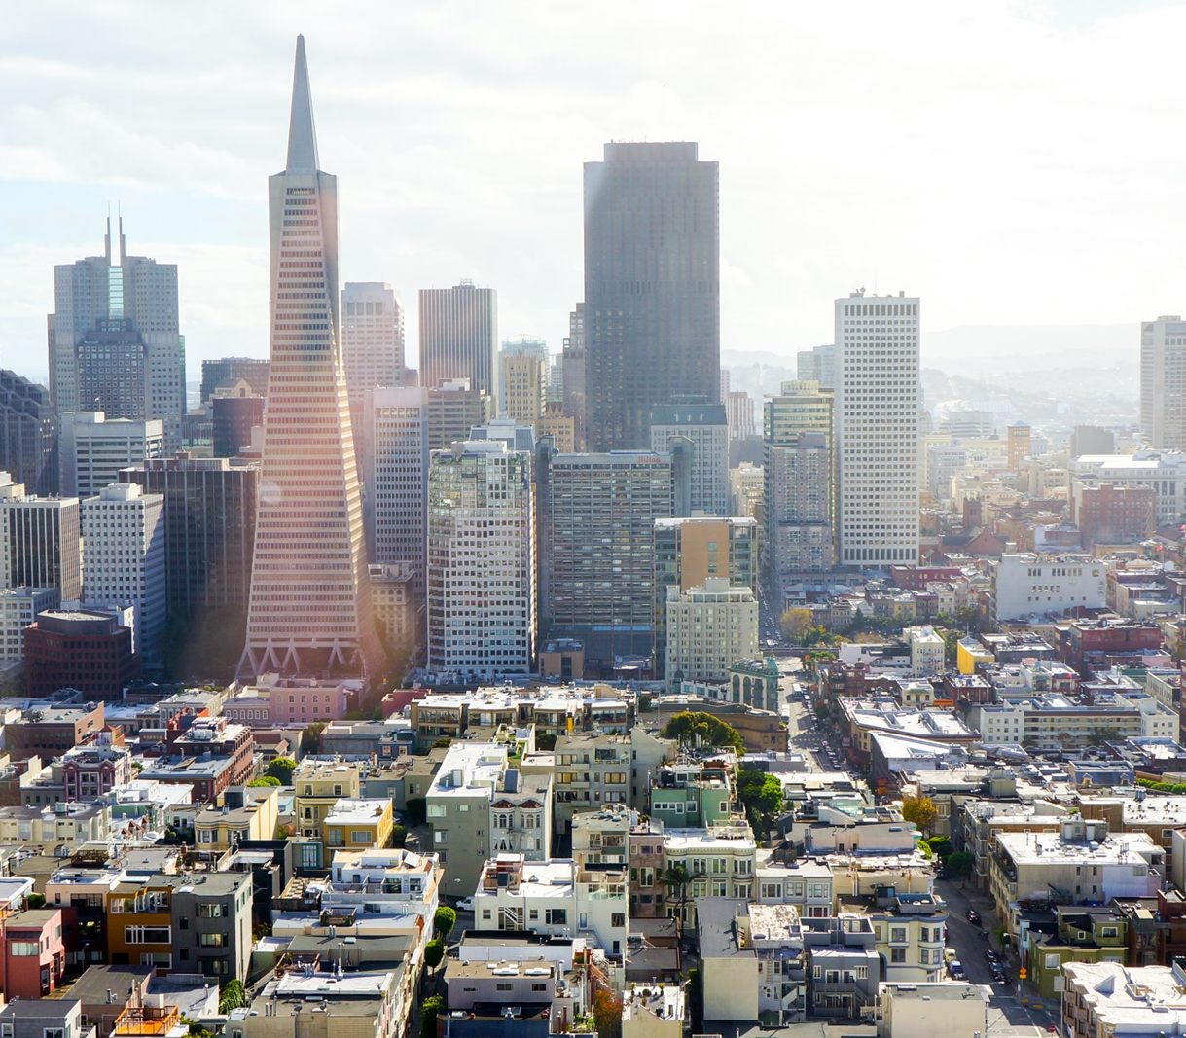

BUSINESS REPORT
谢谢各位欣赏
I long to alleviate this evil, but I cannot, and I too suffer. This has been my life. I have found it worth living, and would gladly live it again if the chance were offered me.

Slide 14

01
ABOUT THIS PROJECT
项目介绍

Slide 15

ABOUT OUR BUSINESS
公司介绍
we are introduced to the narrator, a pilot, and his ideas about grown-ups. Once when I was six years old I saw a magnificent picture in a book, called True Stories from Nature, about the primeval forest. It was a picture of a boa constrictor in the act of swallowing an animal. Here is a copy of the drawing.
we are introduced to the narrator, a pilot, and his ideas about grown-ups. Once when I was six years old I saw a magnificent picture in a book, called True Stories from Nature, about the primeval forest. It was a picture of a boa constrictor in the act of swallowing an animal. Here is a copy of the drawing.

Slide 16




ABOUT OUR BUSINESS
公司介绍
LOGO
BERTRAM WEST
JULY JOHNS
Once when I was six years old I saw a magnificent picture in a book, called True Stories from Nature, about the primeval forest.
Once when I was six years old I saw a magnificent picture in a book, called True Stories from Nature, about the primeval forest.

Slide 17
COMPANY INTRODUCTION
welcome
With equal passion I have sought knowledge. I have wished to understand the hearts of men.
I have wished to know why the stars shine. And I have tried to apprehend the Pythagorean power by which number holds sway above the flux. A little of this, but not much, I have achieved.

Slide 18
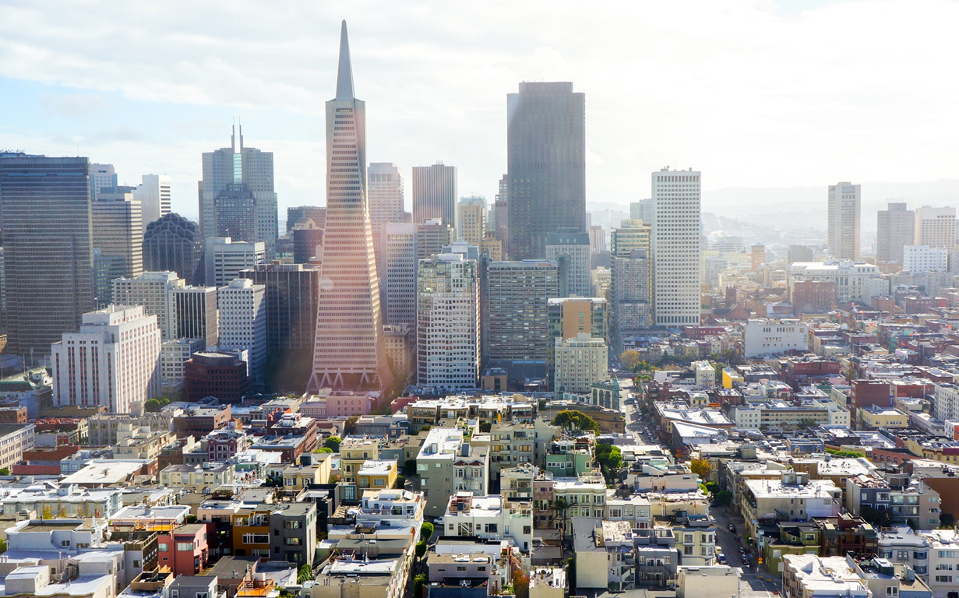
02
DATA ANALYSIS
数据分析

Slide 19
DATA ANALYSIS
数据分析
LOGO
ADD YOUR TITLE
Once when I was six years old I saw a magnificent picture in a book, called True Stories from Nature, about the primeval forest.
we are introduced to the narrator, a pilot, and his ideas about grown-ups.Once when I was six years old I saw a magnificent picture in a book, called True Stories from Nature, about the primeval forest. It was a picture of a boa constrictor in the act of swallowing an animal. Here is a copy of the drawing.
we are introduced to the narrator, a pilot, and his ideas about grown-ups.Once when I was six years old I saw a magnificent picture in a book, called True Stories from Nature, about the primeval forest. It was a picture of a boa constrictor in the act of swallowing an animal. Here is a copy of the drawing.

Slide 20
03
ABOUT OUR SERVICE
业务介绍

Slide 21
ABOUT OUR SERVICE
业务介绍
LOGO
Reason 01
Reason 02
01
ADD TITLE
02
ADD TITLE
Once when I was six years old I saw a magnificent picture in a book, called True Stories from Nature, about the primeval forest.
Once when I was six years old I saw a magnificent picture in a book, called True Stories from Nature, about the primeval forest.
Reason 03
Reason 04
03
ADD TITLE
Once when I was six years old I saw a magnificent picture in a book, called True Stories from Nature, about the primeval forest.
Once when I was six years old I saw a magnificent picture in a book, called True Stories from Nature, about the primeval forest.
05
ADD TITLE
Reason 05
04
ADD TITLE
Once when I was six years old I saw a magnificent picture in a book, called True Stories from Nature, about the primeval forest.

Slide 22
04
ABOUT OUR PRODUCTS
成果展示

Slide 23

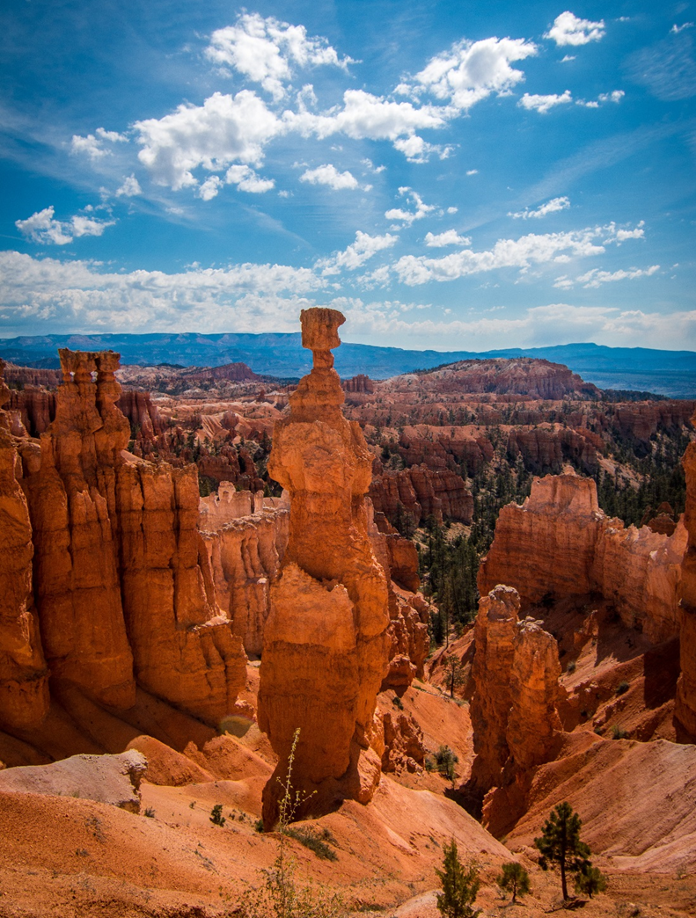
ABOUT OUR PRODUCTS
成果展示
LOGO
ABOUT
OUR PRODUCTS
Once when I was six years old I saw a magnificent picture in a book, called True Stories from Nature, about the primeval forest. It was a picture of a boa constrictor in the act of swallowing an animal. Here is a copy of the drawing.

Slide 24
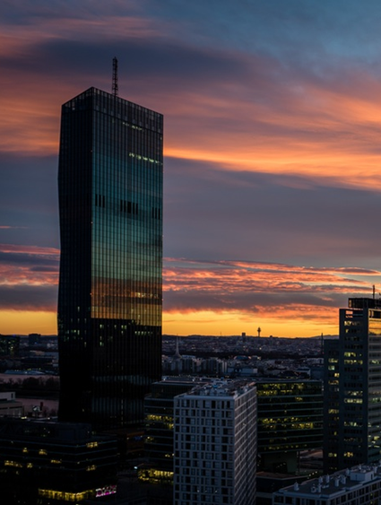



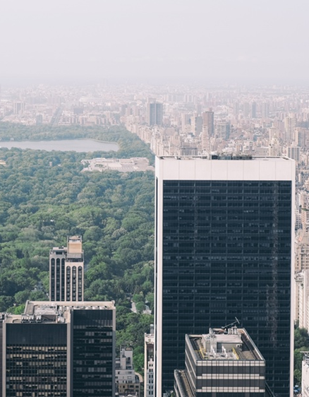

OUR
PRODUCTS
Once when I was six years old I saw a magnificent picture in a book, called True Stories from Nature, about the primeval forest. It was a picture of a boa constrictor in the act of swallowing an animal. Here is a copy of the drawing.

Slide 25



